Slide 1
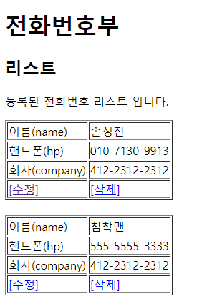
phonebook3 삭제
01
Rqeust(요청)
분석-삭제
Request header
파라미터: action=delete
Request body
파라미터: no=
Tomcat
phonebook3
http://localhost:8000/phonebook3/pbc?action=delete
contoller(servlet)객체
phoneDao 객체
delete일때
personDao
Delete일때
..
personDelete()
rquest
response
list.jsp
객체
Response(응답)
DB
Response header
Response body (리다이렉트코드)

Slide 2
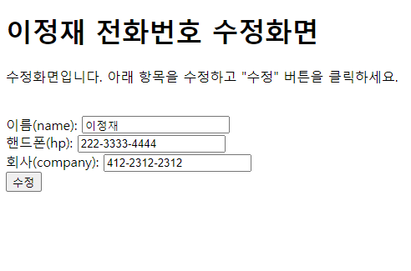
phonebook3 수정폼
01
Rqeust(요청)
분석-수정폼(포워드 설명)
Request header
파라미터: action=uFrom
Request body
파라미터: id=,name=,hp=,company=
Tomcat
http://localhost:8000/phonebook3/pbc?action=uFrom
phonebook3
contoller(servlet)객체
phoneDao 객체
rquest
uFrom일때
Response(응답)
response
Response header
Response body (html)
*포워드
rquest
updataFrom.jsp
객체
response
Rqeust(요청)
Request header
파라미터: action=uFrom
Request body
파라미터: id=,name=,hp=,company=
Response(응답)
Response header
Response body (html)

Slide 3
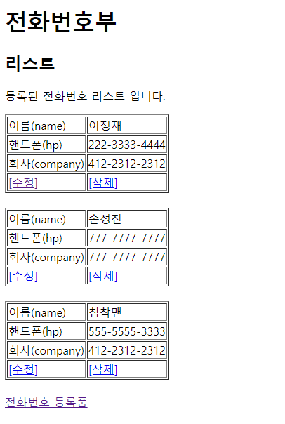
phonebook3 수정
01
Rqeust(요청)
분석-수정
Request header
파라미터: action=update
Request body
파라미터: id=,name=,hp=,company=
http://localhost:8000/phonebook3/pbc?action=update
Tomcat
phonebook3
contoller(servlet)객체
phoneDao 객체
Update일때
personVo
Update일때
personUpdate()
rquest
response
list.jsp
객체
Response(응답)
DB
Response header
Response body (리다이렉트코드)

